Slide 1

Help Center Insights Presentation By Alexandra George

Slide 2
Agenda
Introduction
Part A - Analysis
Part B - Metric Decomposition
Insights & Interpretation
Summary & Next Steps

Slide 3
Introduction
This presentation seeks to deliver an in-depth analysis of trends in escalation rates, highlighting significant insights and practical recommendations.
It aims to provide a clear understanding of the factors influencing escalation rates and offer practical solutions to improve the Help Center’s effectiveness, reduce the escalation rate, and enhance the overall user experience.

Slide 4
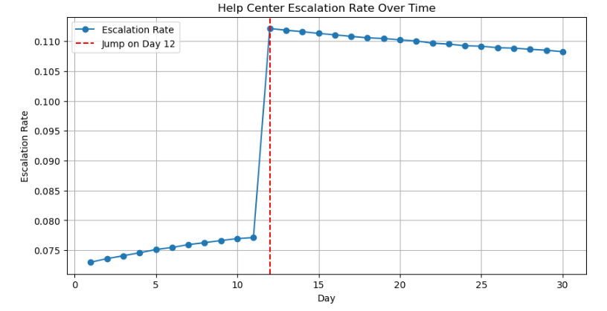
Overall Escalation Rate Trends
Overall Trend:
The escalation rate exhibits variations during the first 11 days, displaying slight changes in the proportion of sessions resulting in a support case. Throughout the month, the daily escalation rate continues to fluctuate, with a significant increase observed on Day 12.
Spike on Day 12:
This pronounced rise indicates that an event or external influence may have impacted the Help Center's performance on that particular day.

Slide 5
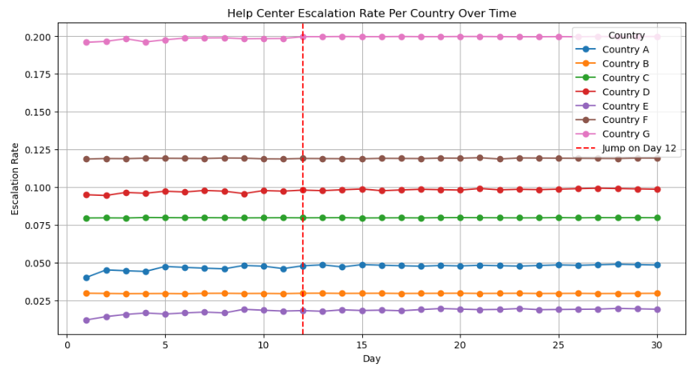
Country-Specific Escalation Rate Trends
An analysis of session proportions by country was conducted to assess whether changes in traffic contributed to the rise in escalation rates.
There are clear variations in escalation rates across different countries.
Some countries consistently show higher escalation rates, which may indicate lower Help Center efficiency or different user behaviors in those regions.
The spike on Day 12 is particularly pronounced in certain countries, pointing to a possible regional issue or policy change.

Slide 6
Part B - Kitagawa-Oaxaca-Blinder Decomposition Analysis
The Kitagawa‑Oaxaca‑Blinder Decomposition Technique
Key Insights
Rate Effect: A notable part of the increase in the escalation rate is influenced by alterations in the way users from certain countries and browsers engage with the Help Center.
Proportion Effect: Variations in session numbers across different countries and browsers also impact the overall escalation rate.
The analysis reveals that both elements—shifts in user behavior and changes in user demographics—are significant in affecting the trends of the escalation rate.
The Kitagawa‑Oaxaca‑Blinder decomposition gives you a systematic framework to distinguish whether a change in an aggregate metric is driven by each group’s rates going up or down, or by changes in the size of each group.
The method is applied to understand the factors contributing to changes in escalation rates.

Slide 7
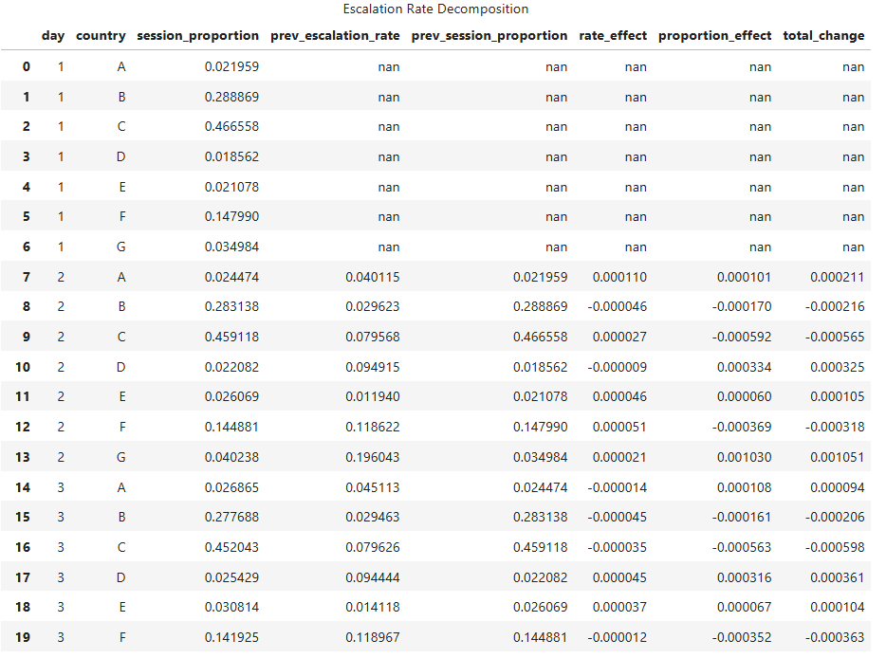

Slide 8
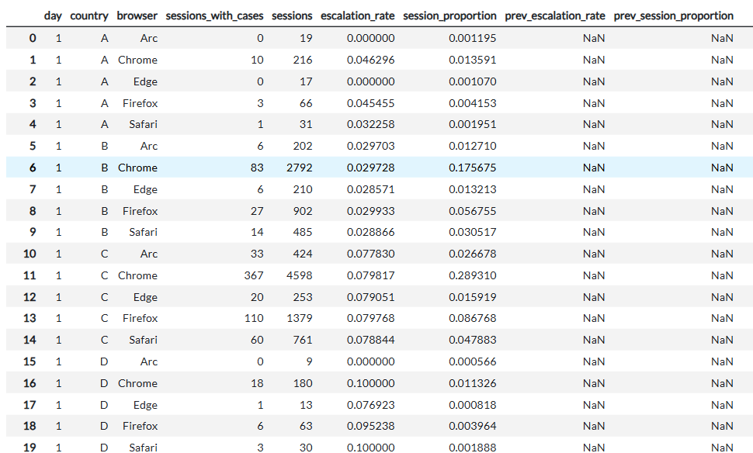
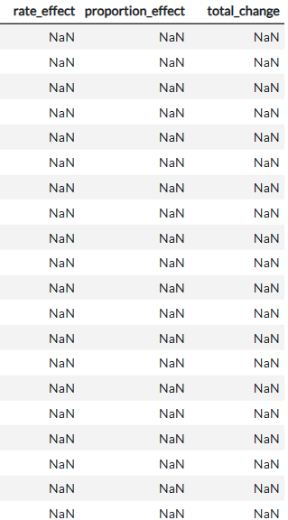

Slide 9
Recommendations
Practical suggestions derived from the findings:
Investigate the Cause of the Day 12 Spike
Review internal Help Center changes, product updates, or external events that may have led to the sharp increase in escalation rates.
Conduct a qualitative review of user feedback and support tickets from Day 12 to identify specific pain points.
Optimize Help Center for High Escalation Countries
Improve Help Center content localization for countries with consistently high escalation rates.
Conduct usability testing to understand user challenges in these regions.
Address Browser-Specific Disparities
Analyze performance and compatibility issues for browsers with higher escalation rates.
Optimize the Help Center experience for these browsers, ensuring accessibility and usability improvements.
Enhance Self-Service Effectiveness
Introduce interactive troubleshooting guides for common issues.
Implement AI-driven suggestions to direct users to relevant articles before they escalate to support cases.
Monitor Future Trends & Perform A/B Testing
Track escalation rates over time to assess the impact of implemented changes.
Conduct A/B testing on different Help Center layouts and content formats to determine what reduces escalations most effectively.

Slide 10
Next Steps
Review findings with
Senior LEADER
Implement changes to Help Center resources based on results
Monitor future trends, refine the escalation rate tracking approach AND ITERATE ON SUPPORT STRATEGIES

Slide 11

Thank you

